Slide 1
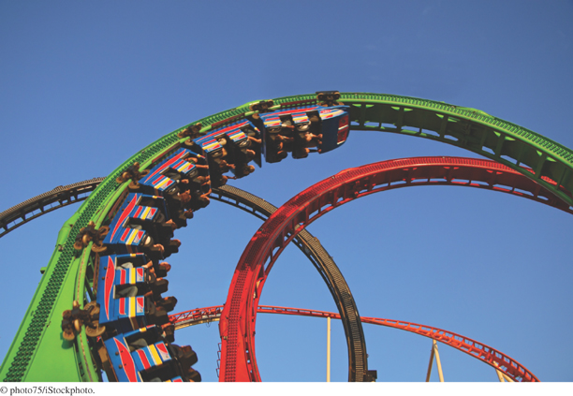
Java Concepts
Early Objects
Seventh Edition
Cay Horstmann
Chapter 6
Loops
Copyright © 2012 John Wiley & Sons, Inc. All rights reserved.
Title

Slide 2
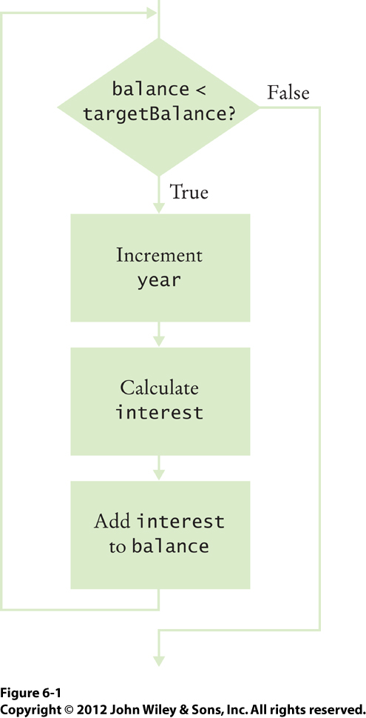
Fig_6-1

Slide 3
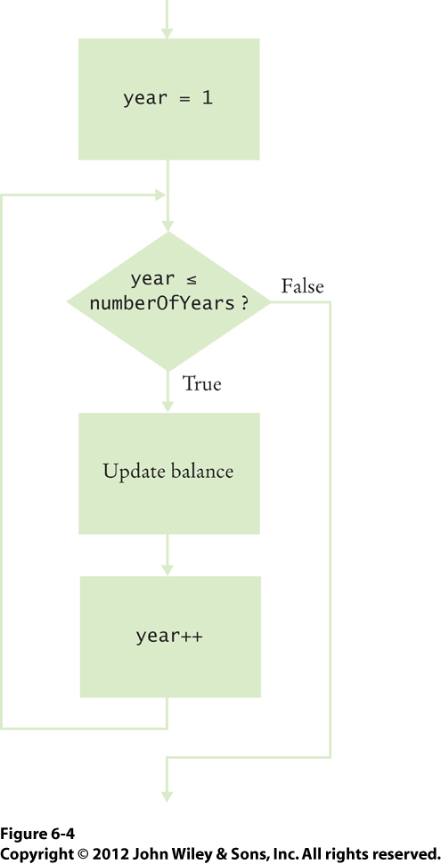
Fig_6-4

Slide 4
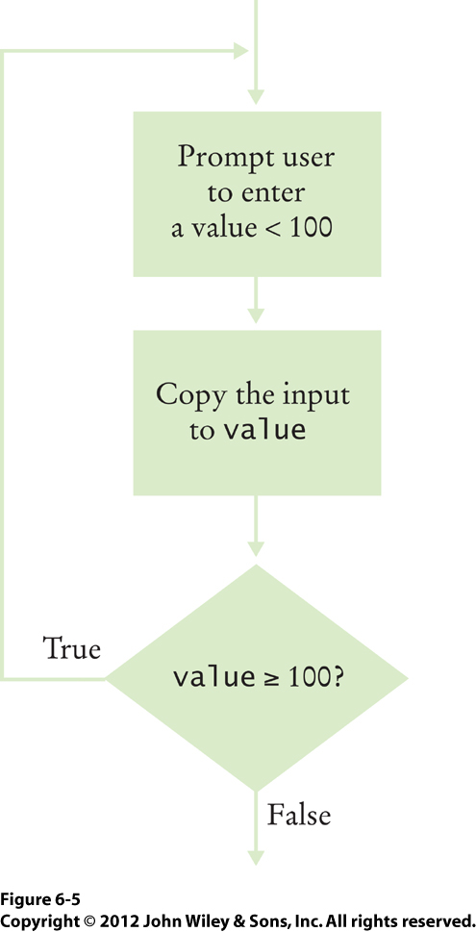
Fig_6-5

Slide 5
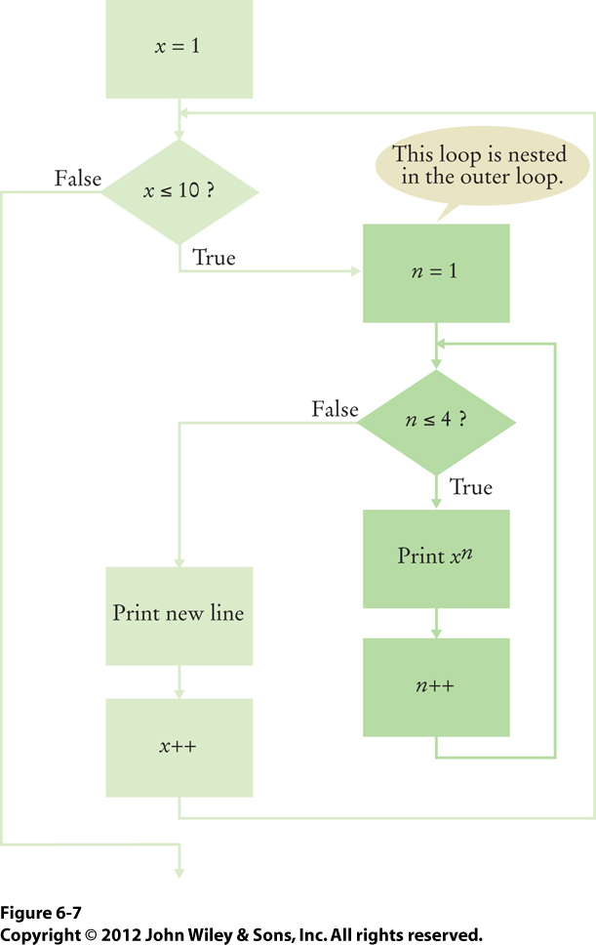
Fig_6-7

